Slide 1
Sweet Karolines Cakes Analysis
By: Silver Souls
Benjamin Benoit, Nick Gay, Matt Holston, Alex Mattingly, Adam Schweitzer and Nick Taylor

Slide 2
Problem Statement
Sweet Karoline’s Cakes is in need of a system to improve efficiency and organization of its business processes.
Without such a system, Karoline herself has to devote more time and resources into managing communications with customers as well as payment options and other processes.
This takes away time to bake for customers, but such a system would give Karoline more time and effectively more revenue.

Slide 3
Problem Statement
Core Focus Areas:
Customer Accessibility
Coordinating Communication
Social Media Exposure
Business Continuity

Slide 4
Process Models
Customer Contact
Current: Must be in personal contact with Karoline
Customer Interest
Current: Gained after talking to Karoline
Create Order
Current: Must message or call Karoline
Proposed: Will be generate through website and social media
Proposed: Generated through website and social media
Proposed: Will create order via an online form
Fulfill Order
Karoline will fulfill the order
Delivery of Product
Current: Customers pick up or Karoline delivers within a small radius of her location
Proposed: Customer may pick up or have it delivered for a small fee
Back of Office
Current: Has no system
Proposed: Will track all numbers and inventory in a system

Slide 5
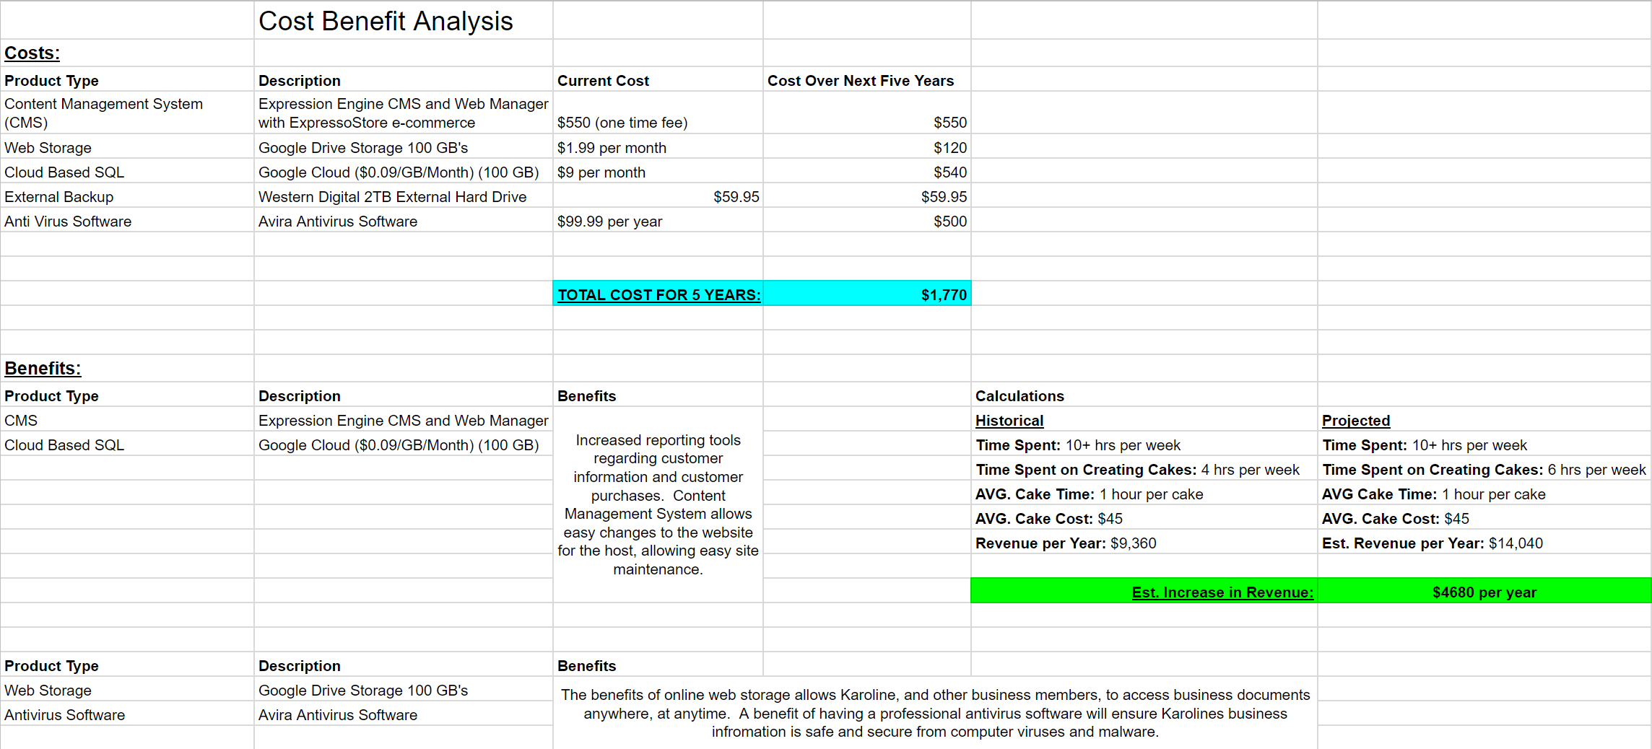
Cost-Benefit Analysis

Slide 6
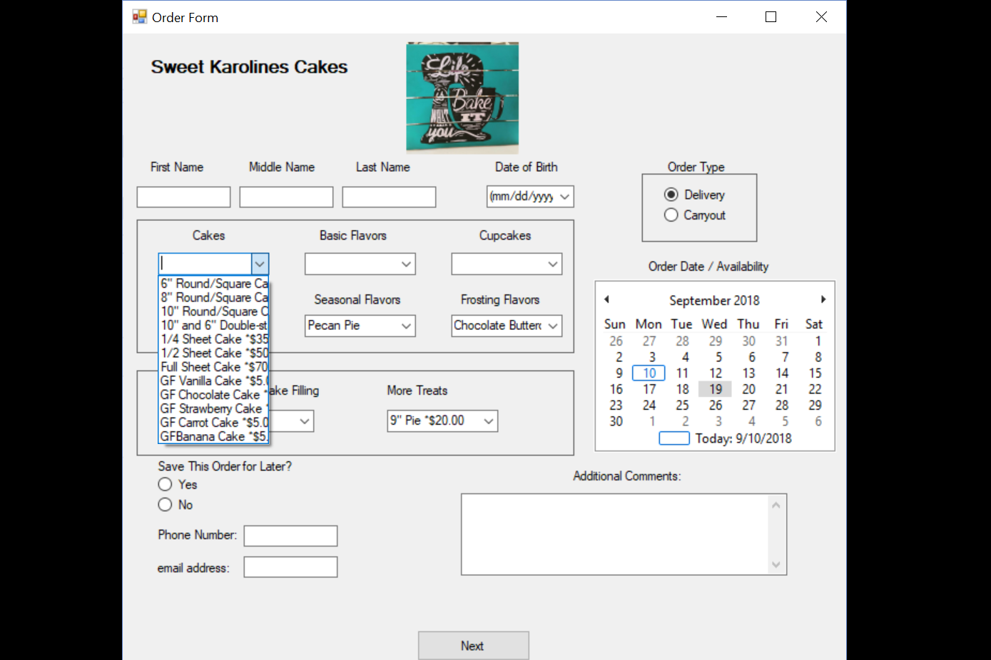
Form
Notes:
Talk about lack of Unified communication and lack of accessibility with the current Facebook usage

Slide 7




Social Media Exposure
Problems:
No Twitter
No Instagram
No Advertisements from social media
Incorrect information and inefficient Facebook Page

Slide 8
Business Continuity
Business data is left on personal devices
Business data is not backed up regularly
^{Business data is not protected}
No streamline platform for customer communication

Slide 9
Summary
Our Capital Predictions:
TOTAL COST: $1770 (over 5 year period)
INCREASED BENEFITS: $4,680 (per year)
Customer Accessibility
Lacks accessibility
Coordinating Communication
Too many different forms of communication
Social Media Exposure
Lacking a Social Media presence
Business Continuity
Business data is on personal devices and is at risk

Slide 10

Bibliography
“Products & Services | Google Cloud Platform” Google, Google, cloud.google.com/products/
“ExpressionEngine CMS” ExpressionEngine, ExpressionEngine, expressionengine.com/store

Slide 11
Questions?

